Slide 1
Smart Farmer - IoT Enabled Smart Farming Application
(TEAM ID: PNT2022TMID41919)

Slide 2
CONTENT
Welcome
Team details
Abstract
Problem Statement
Proposed Solution
Technical Architecture
Advantage
Disadvantage
Future Scope
Conclusion

Slide 3
WELCOME:
We express our warm welcome to this project demonstation session “professional” readliness for innovation ,employability and entrepreneurship” program from the “NALAIYA THIRAN” scheme,executed by IBM.
We welcome all the industry mentors, Faculty mentors, Industry evaluators for our virtual presentation.
First of all we would like to thank each and everyone behind this program for providing this wonderful opportunity to enhance our skills.

Slide 4
TEAM DETAILS:
RAHUL S (622519104030)
PRAKASH T (622519104029)
ALFIN BELAN P (622519104004)
DHANUSIGA S (622519104008)

Slide 5
ABSTRACT
Smart Farming based on IoT, this is an emerging system increases the quantity and quality of agricultural products. IoT devices provide information about nature of farming fields and then take action depending on the user’s input.In this an IoT based advanced solution for monitoring the soil conditions and atmosphere for efficient crop growth is presented. The developed system is capable of monitoring temperature, humidity, soil moisture level, smart irrigation using Node-MCU and several sensors connected to it. Also, a notification in the form of SMS will be sent to the user phone about environmental conditions of thefield.

Slide 6
PROBLEM STATEMENT:
The traditional agriculture cannot meet the requirements of modern agriculture which requires high-yield, high quality and efficient output.
Thus, it is very important to turn towards modernization of existing methods and using the information technology and data over a certain period to predict the best possible productivity and crop suitable on the very particular land.
The adoptions of access to high-speed internet, mobile devices, and reliable, low-cost satellites (for imagery and positioning) are few key technologies characterizing the precision agriculture trend

Slide 7
PROPOSED SOLUTION
In olden days, Traditional farming methods were used where the soil and livestock were managed manually.
These methods were time consuming and expensive.
And also sometimes the predictions of human were not accurate also difficult to detect outbreaks at an early stage.
The motive of smart farming is to increase the quality and quantity of agricultural goods at the same time keeping in mind the cost and energy usage.
IoT is responsible for modernizing the agricultural field by using proficient methods and instruments to manage crops, soil and animals.
This in turn has led to decrease in the waste generation and a phenomenal increase in productivity. This is smart agriculture using IoT

Slide 8
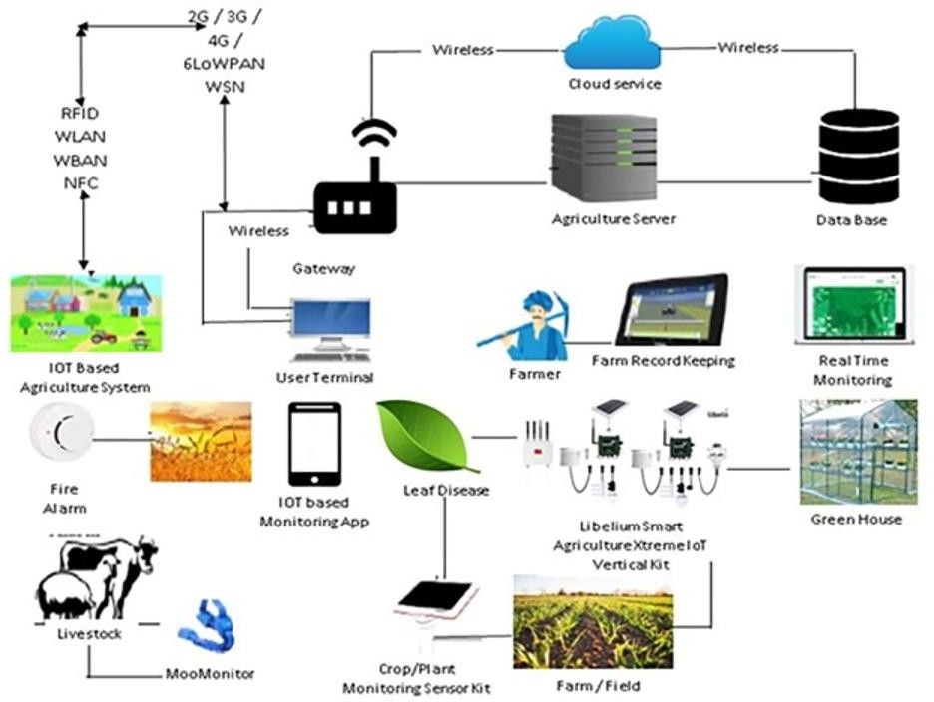
TECHNICAL ARCHITECTURE:

Slide 9
ADVANTAGE
Increased work efficiency. One of the greatest things about Smart Farming is its potential to save valuable time.
Improved fuel efficiency. Smart Farming allows farmers to be much more precise.
Reduced consumables.
Increased yields.

Slide 10
DISADVANTAGE
The main disadvantage is the time it can take to process the information.
Farmers are so busy with harvesting and caring for their crops that they may not have time to process data.
There are also issues with the water supply, as well as issues with the cost of the technology, which can be quite expensive.

Slide 11
FUTURE SCOPE:
Through collecting data from sensors using IoT devices, you will learn about the real-time state of your crops.
The future of IoT in agriculture allows predictive analytics to help you make better harvesting decisions.
Pattern forecasting can be used by farmers to predict weather patterns and crop harvesting.

Slide 12
CONCLUSION
In IoT-based smart farming, a system is built for monitoring the crop field with the help of sensors (light, humidity, temperature, soil moisture, etc.) and automating the irrigation system.
The farmers can monitor the field conditions from anywhere.

Slide 13
THANKING YOU

